Slide 1
3a: Normal Galaxies
The following are images of other galaxies, far beyond the Milky Way.
Note the detail visible in the images.

Slide 2
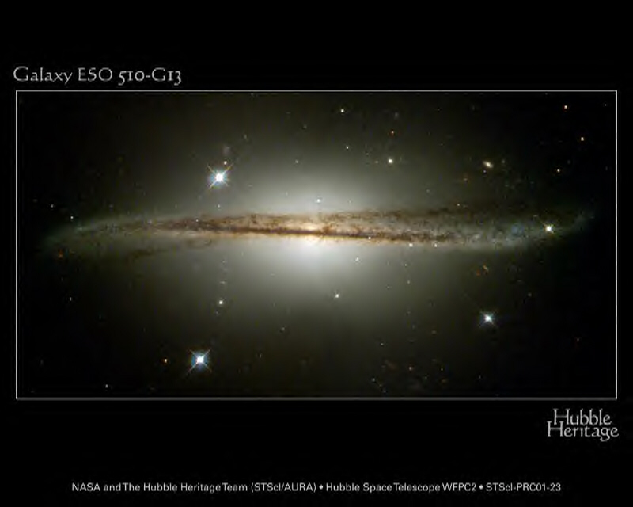
ESO 510-G13

Slide 3
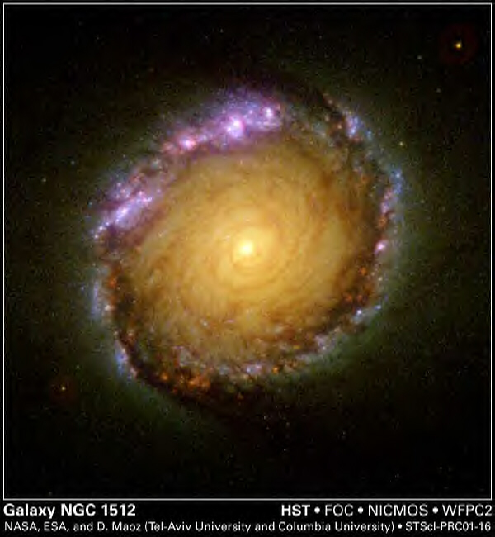
NGC 1512

Slide 4
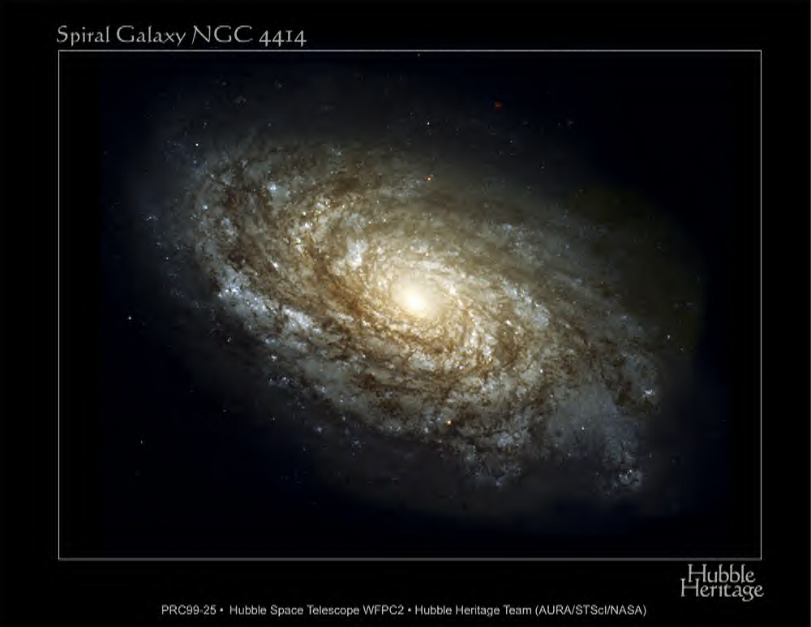
NGC 4414

Slide 5
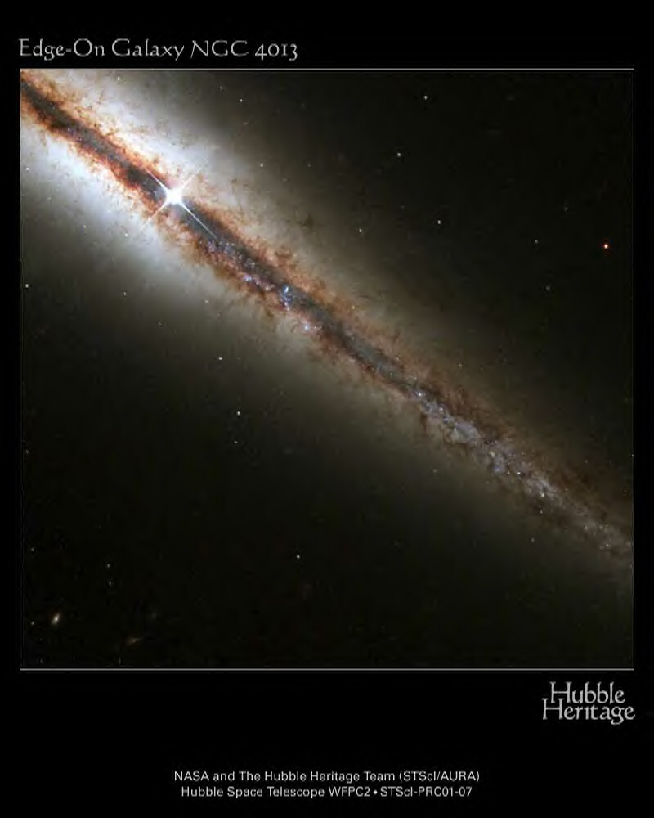
NGC 4013

Slide 6
3b: Active Galaxies
The following are images of other galaxies, far beyond the Milky Way.
These galaxies all exhibit excessive outputs of energy from their cores.
Note the detail visible in the images.

Slide 7
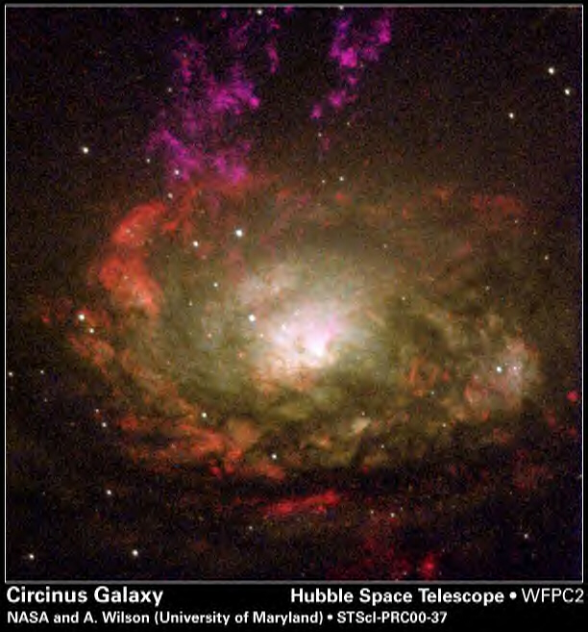
Circinus

Slide 8
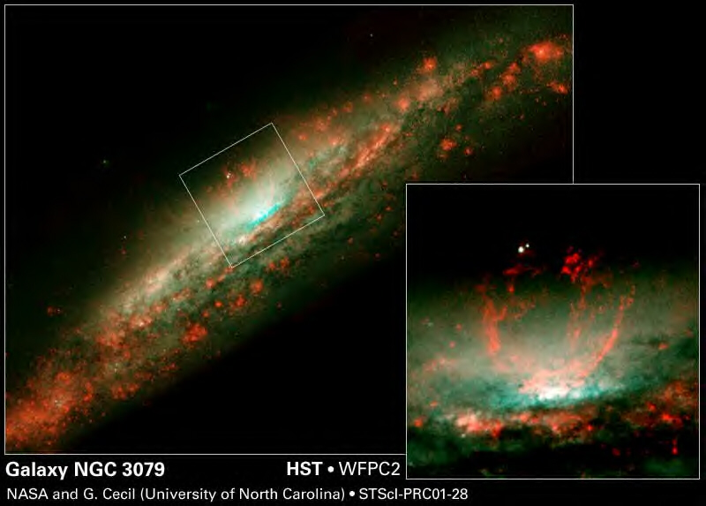
NGC 3079

Slide 9
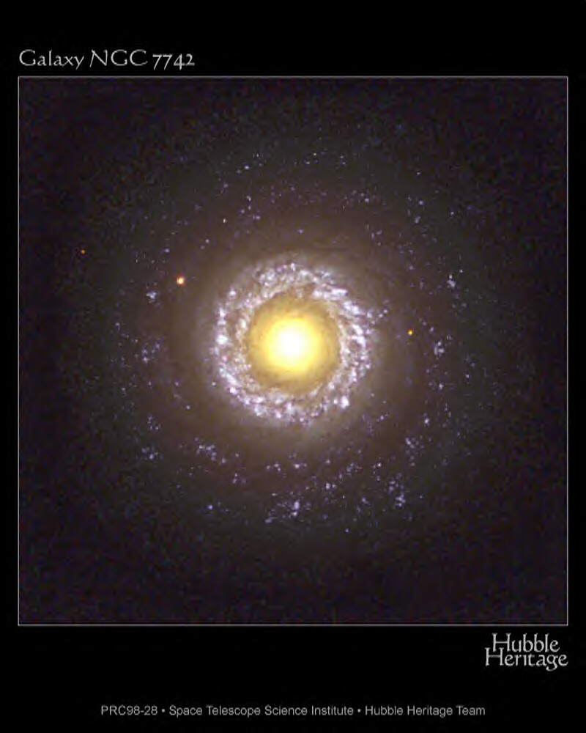
NGC 7742

Slide 10
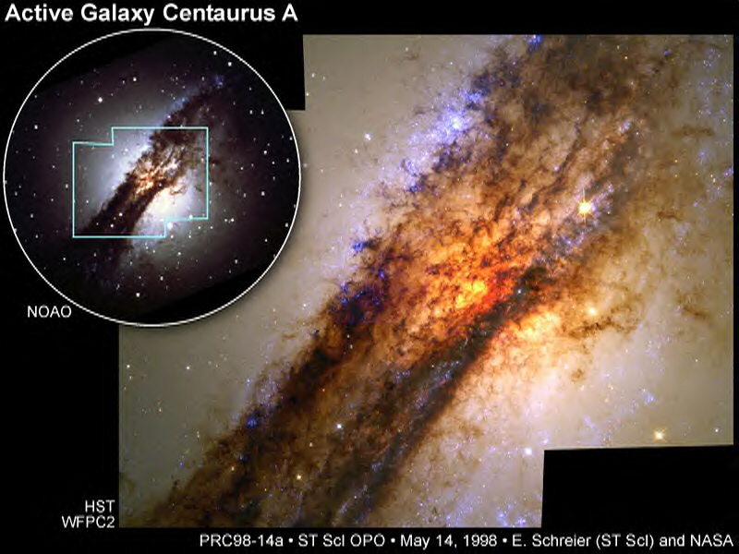
Centaurus A

Slide 11
3c: Galaxy Clusters
The following are images of other galaxies, far beyond the Milky Way.
Galaxies tend to group into clusters.
Here are a couple galaxy clusters, as captured by Hubble.

Slide 12
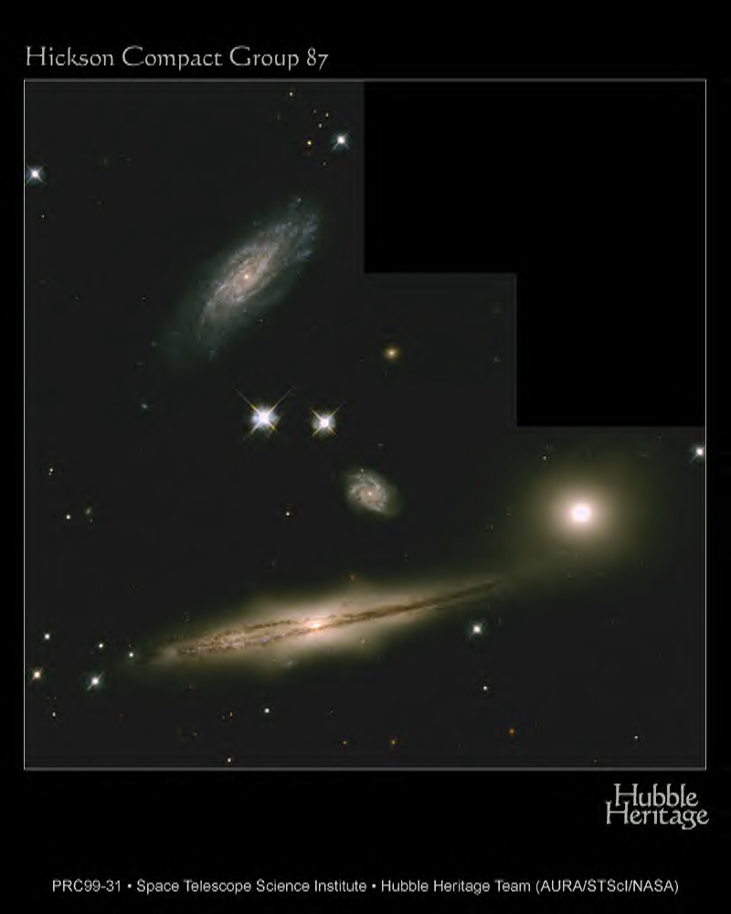
HCG 87

Slide 13
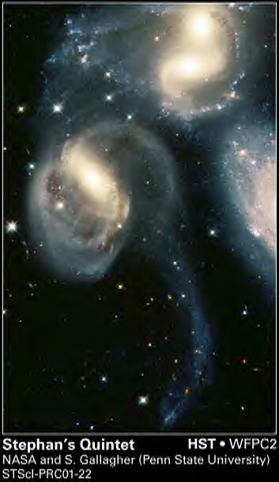
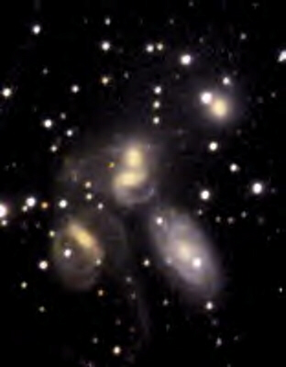
NGC 7318-19: Stephan’s Quintet
Professional

Slide 14
3d: Interacting Galaxies
The following are images of other galaxies, far beyond the Milky Way.
Although distances between galaxies are usually vast, in rich clusters collisions can often occur.
Here are a few images of such encounters.

Slide 15
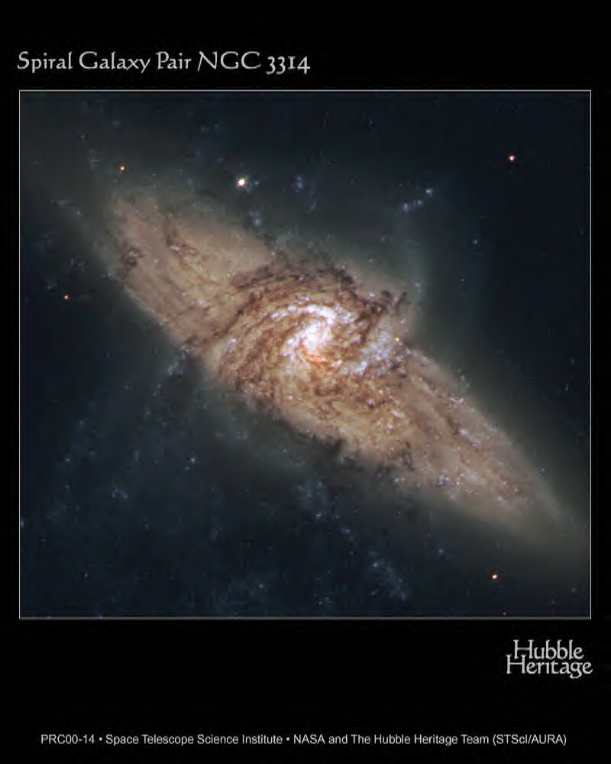
NGC 3314

Slide 16
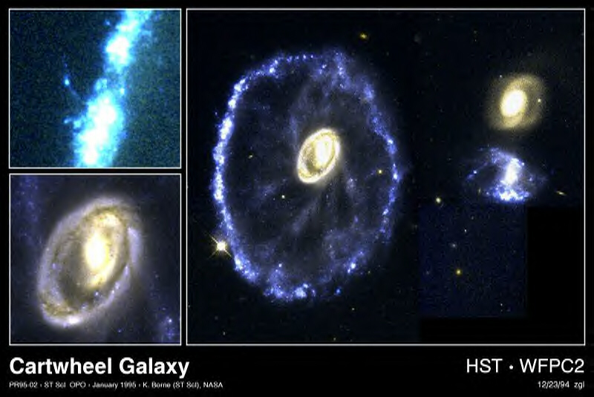
The Cartwheel

Slide 17
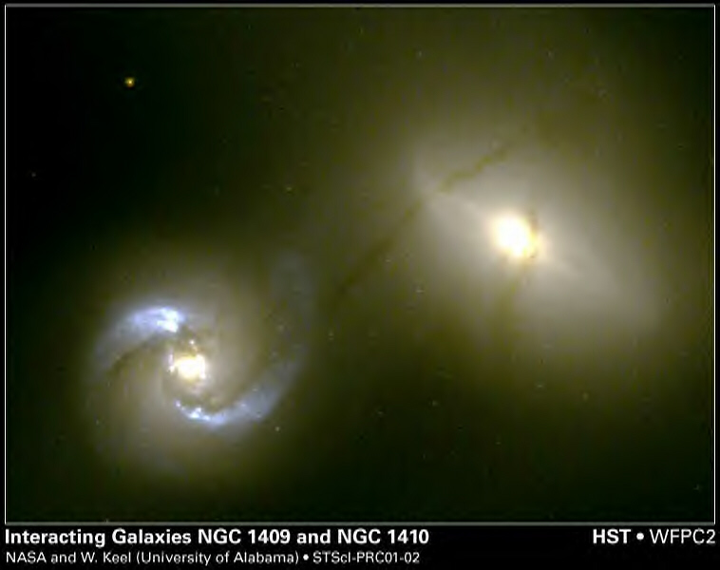
NGC 1409 and 1410

Slide 18
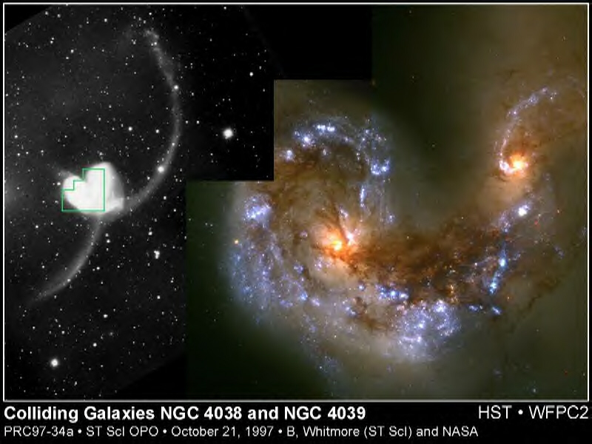
NGC 4038 and 4039

Slide 19
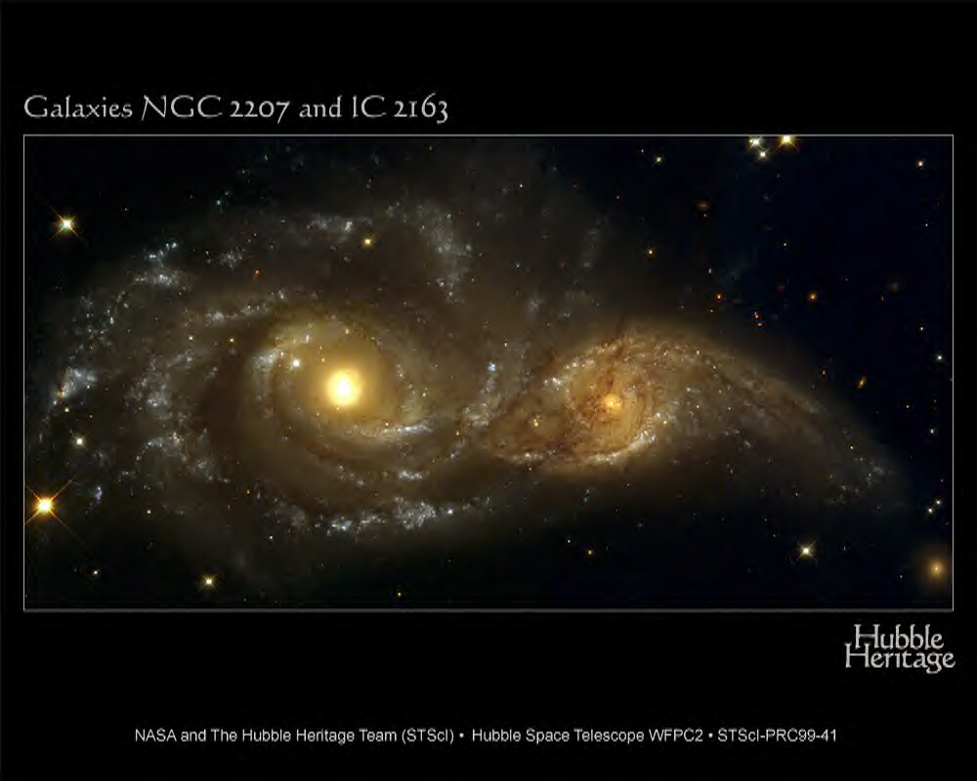
NGC 2207 and IC 2163

Slide 20
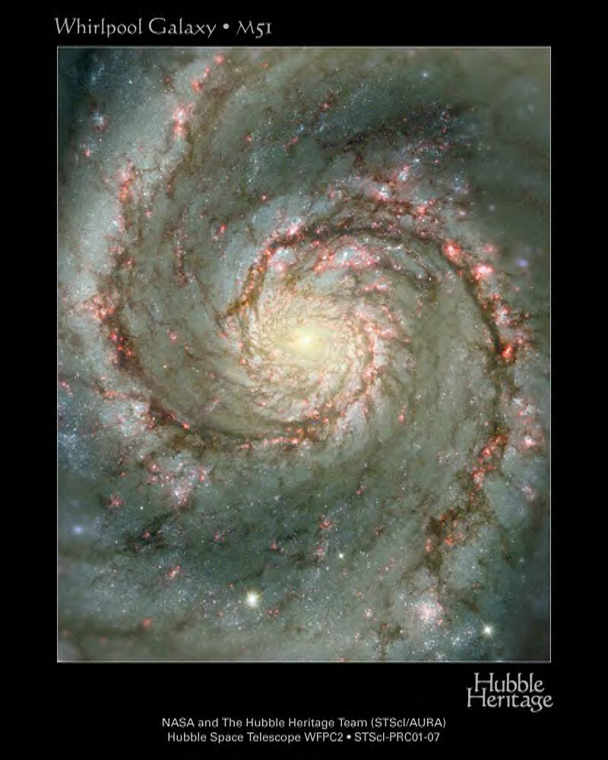
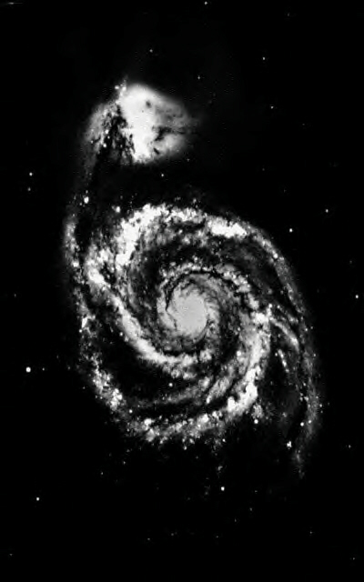
M51 – The Whirlpool Galaxy
Professional

